Slide 1
AI Intro Basics #3
Large Language Models, Transformers, RAG
Roland Potthast, Stefanie Hollborn and Jan Keller

Slide 2
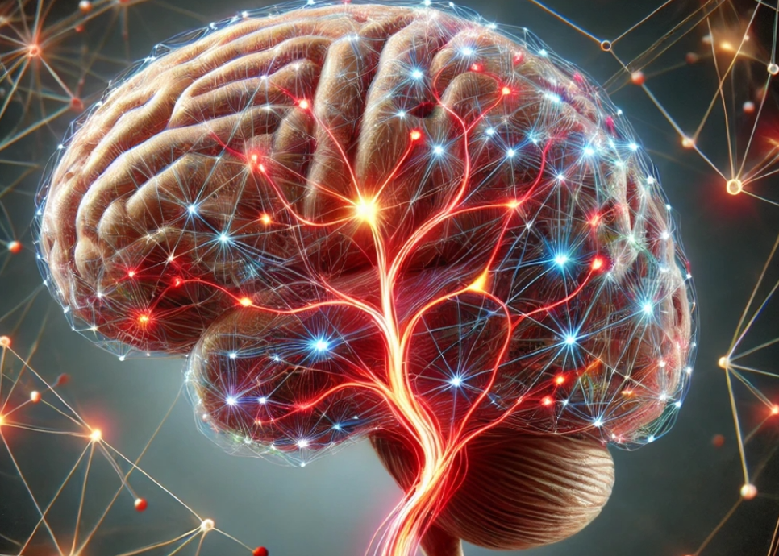
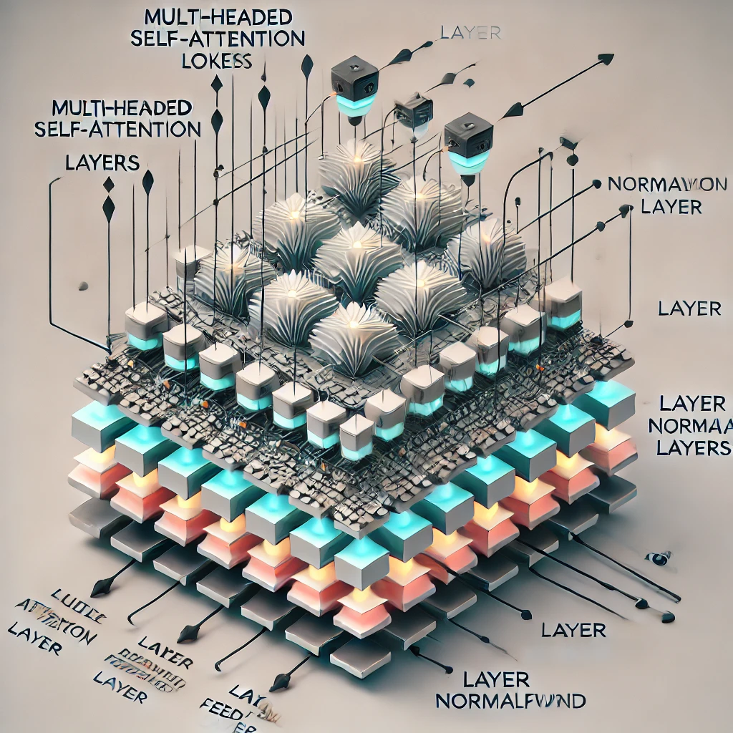
E-AI Basic Tutorials
Tutorial E-AI Basics 1: September 16, 2024, 11-12 CEST
Intro, Environment, First Example
1.1 Basic Ideas of AI Techniques (20') [SH]
1.2 Work Environment (20') [RP]
1.3 First Example for AI - hands-on (20') [JK]
Tutorial E-AI Basics 2: September 18, 2024, 13-14 CEST
Dynamics, Downscaling, Data Assimilation Examples
2.1 Dynamic Prediction by a Graph NN (20') [RP]
2.2 Data Recovery/Denoising via Encoder-Decoder (20') [SH]
2.3 AI for Data Assimilation (20') [JK]
Tutorial E-AI Basics 3: September 23, 2024, 11-12 CEST
LLM Use, Transformer Example, RAG
3.1 Intro to LLM Use and APIs (20') [RP]
3.2 Transformer for Language and Images (20') [JK]
3.3 LLM Retrieval Augmented Generation (RAG) (20') [SH]
3.1
AI generated Images, © Roland Potthast 2024

Slide 3
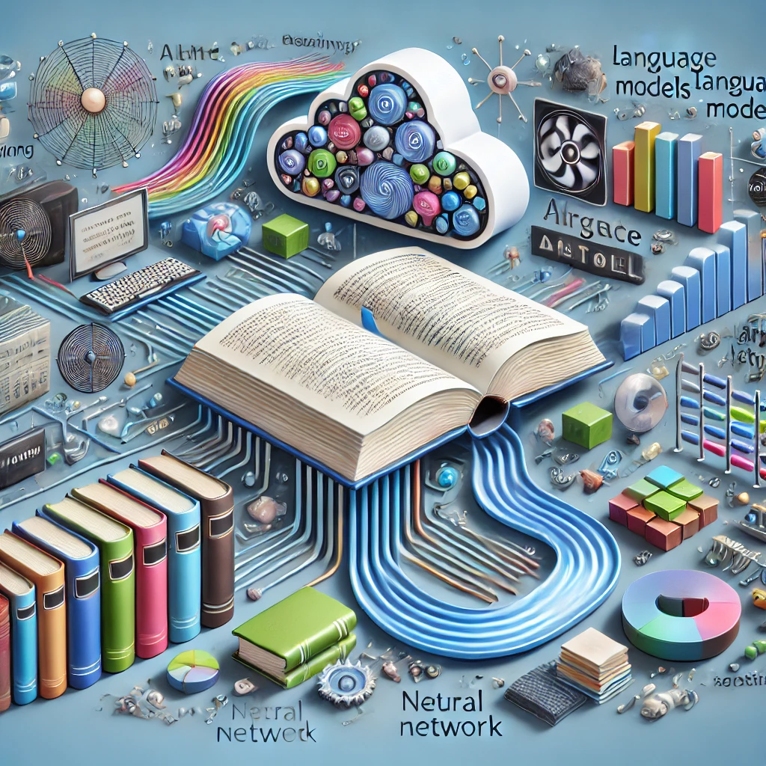
Large Language Models (LLMs)
LLMs are models based on deep learning techniques, specifically neural networks, to process and understand patterns in the text.
LLMs are trained on massive datasets that include books, websites, and other text sources.
Through training, LLMs learn how words, sentences, and paragraphs relate to each other, enabling them to understand and generate coherent text.
After training, LLMs can generate responses, summarize information, and assist with various language tasks based on user input.

Slide 4
Large Language Models, a Snapshot
# | Model Name | Comment
1 | GPT-4 | Last version from OpenAI, advanced text generation capabilities.
2 | GPT-3.5 | Widely used earlier version with strong performance.
3 | BERT | Bidirectional model for natural language understanding tasks.
4 | DistilBERT | Smaller, faster version of BERT, maintaining good performance.
5 | T5 | Text-to-text model, flexible for various NLP tasks.
6 | RoBERTa | Optimized version of BERT, better performance on benchmarks.
7 | XLNet | Autoregressive model that considers word sequence permutations.
8 | ALBERT | Lightweight version of BERT with reduced size and comparable performance.
9 | Megatron-Turing NLG | Massive model with strong text generation capabilities.
10 | Claude | Focused on safety and alignment in language generation.
11 | LLaMA | Research-focused family of models with strong performance.
12 | OPT | General-purpose language models developed by Meta.
13 | BLOOM | Multilingual model developed through collaborative research.
14 | Cohere Command R | Designed for retrieval-augmented generation tasks.
15 | ChatGPT | Conversational agent tuned for dialogue, based on GPT-3.5 and GPT-4.

Slide 5
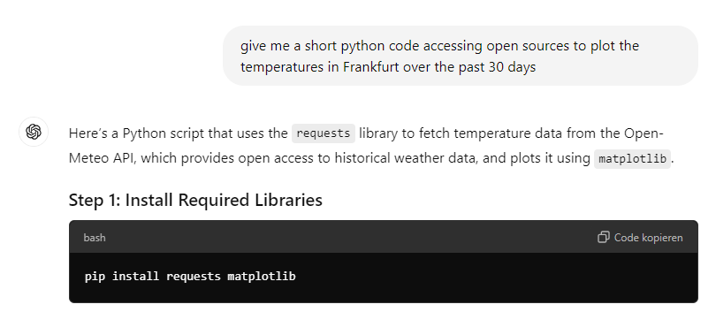
Using LLMs for various tasks becomes a fantastic new tool!
The LLM can help you to access information
The LLM generates code and explains or documents code!

Slide 6
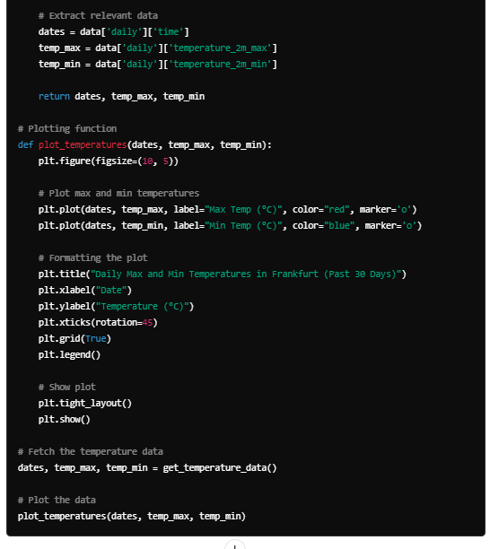
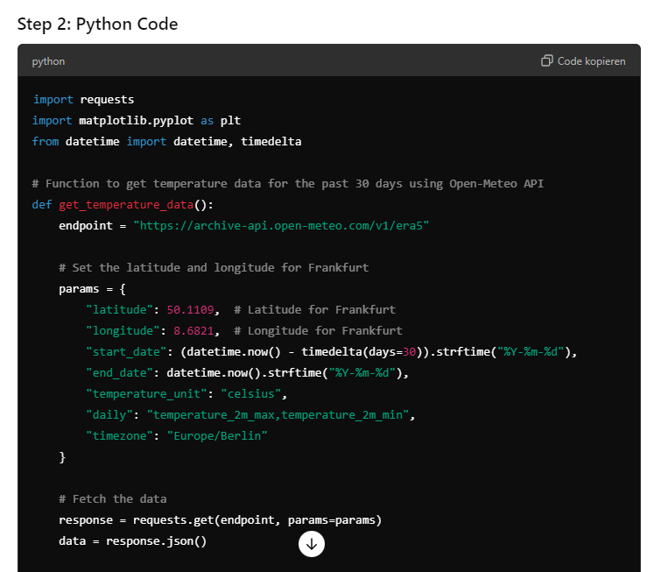
Get Python Code from your LLM
The LLM generates code and explains or documents code!

Slide 7
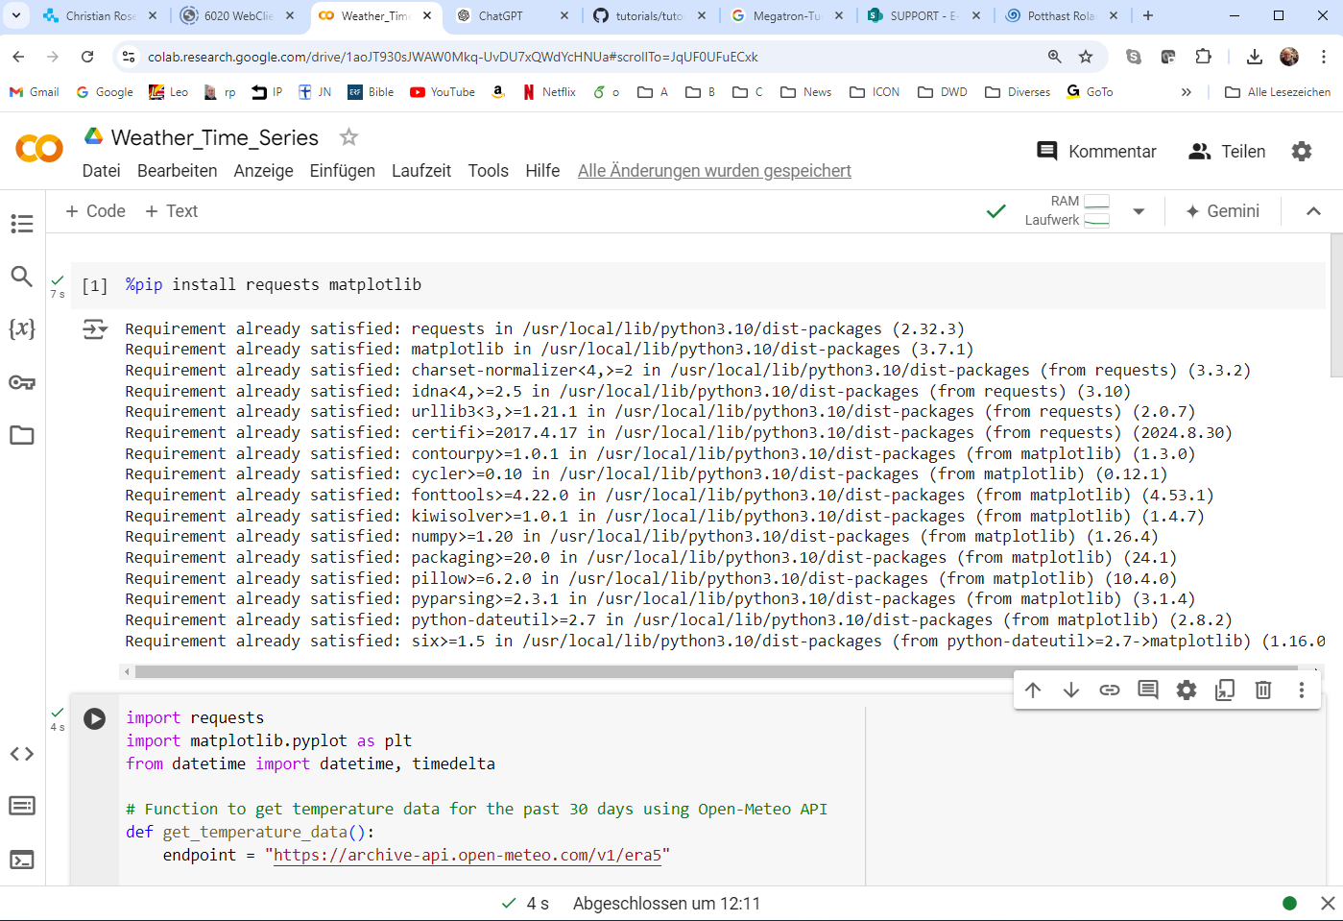
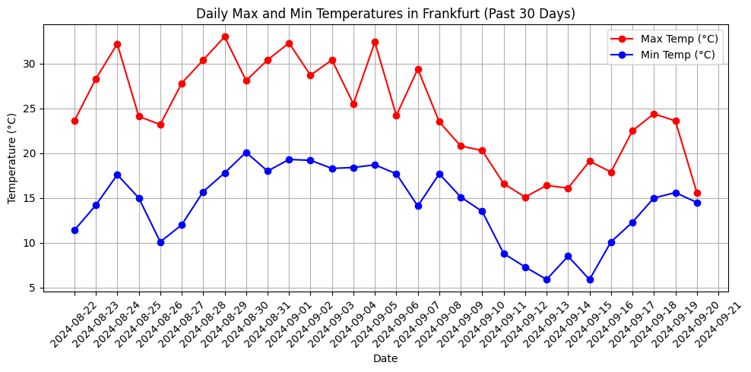
Code can be executed directly on the Cloud or within the LLM environment
Within 2 minutes we get the result
Using a Cloud-based Notebook

Slide 8

LLM/GPT Usage and Access
Modular Options
User Frontend
Backend
LLM Server
Web Interface
Commercial Backend
Commercial Server
Shell Interface
Local Backend
Local Server
My Application
Application Backend
Application Server

Slide 9
Backend API – how it works
Request: Your application sends an HTTP request (usually a POST request) to the API endpoint. The request typically includes the input text or prompt you want the LLM to process.
Processing: The backend API tokenizes the input text, prepares it for the LLM, and sends the tokens to the model.
Model Inference: The LLM processes the tokens, generates predictions, and produces an output (usually text).
Response: The API receives the LLM’s output, converts it back to human-readable text, and sends it as an HTTP response to your application.

Slide 10
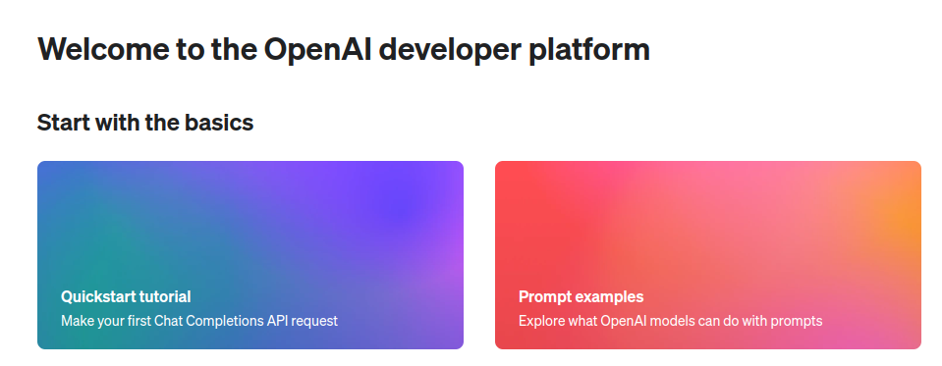
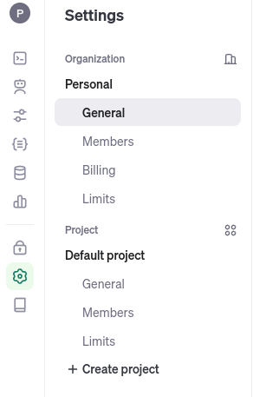
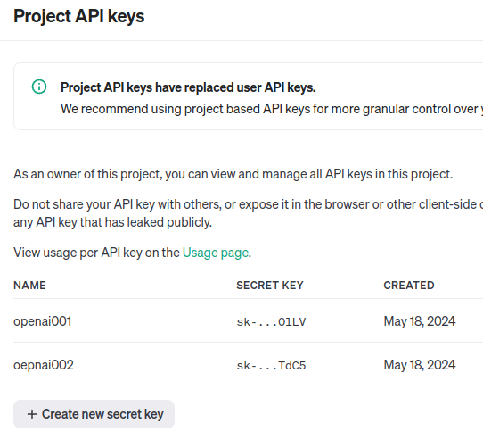
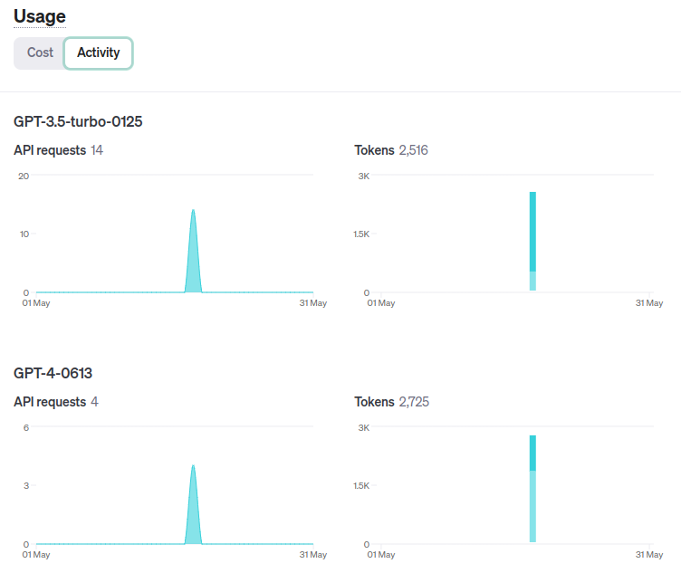
Commercial Backend Example
1. Sign in at openai.com
2. Provide Payment Methods (Credit card)
3. generate an openai_api_key

Slide 11
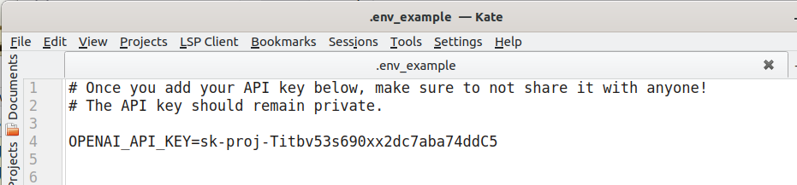
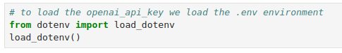
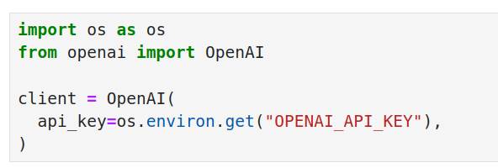
Commercial Backend Example
4. Put your
OPENAI_API_KEY into
the .env file
5. pip install python-dotenv
6. Now the key is available in your python notebook by load_dotenv()
6. Now you can connect to ChatGPT 3.5 or 4 easily by the openai package.

Slide 12
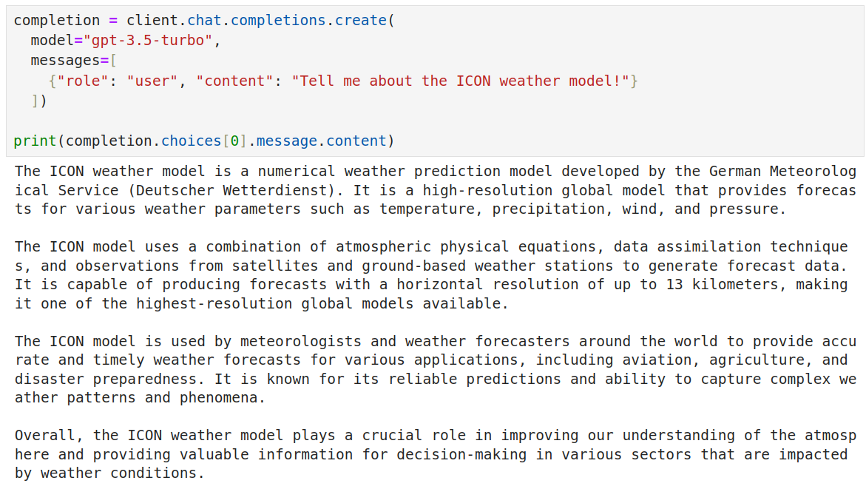
Commercial Backend Example
Here the Request
Answer in the completion structure

Slide 13
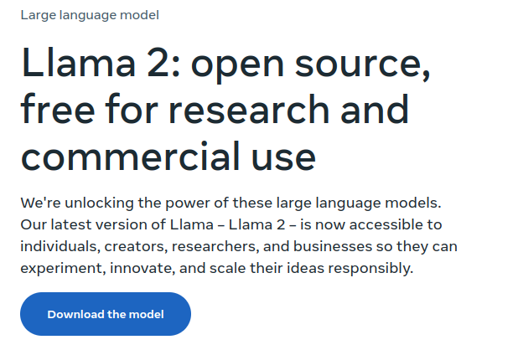
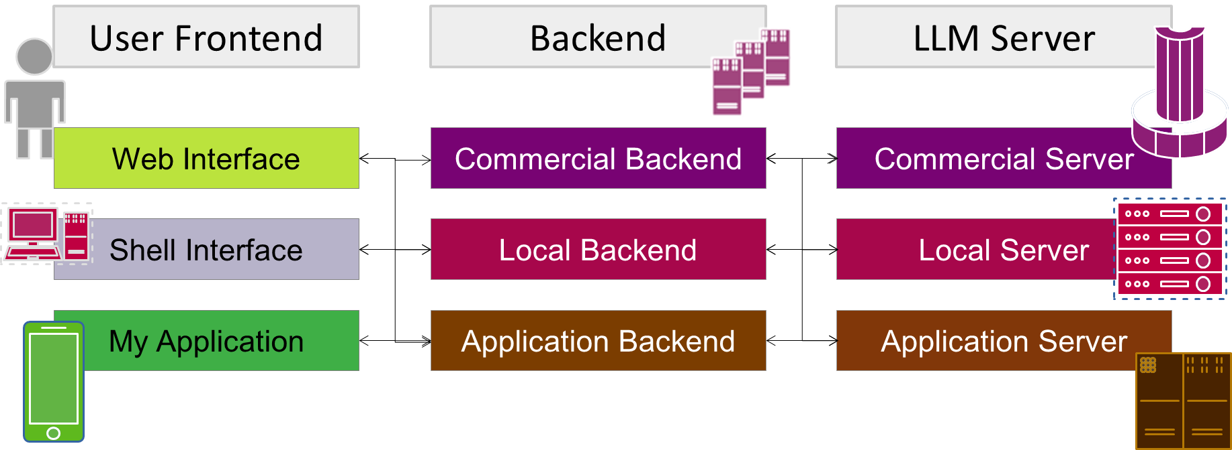
LLM in my Institution
LLM on your own linux machine or linux server
Installing my own open source LLM server
Full Privacy
Full Control
Pretrained

Slide 14
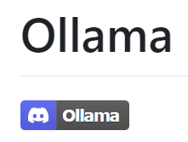
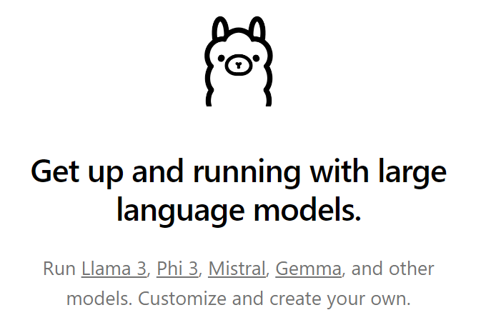
LLM on your own linux machine or linux server
Ollama is a framework to
install
use and
fine-tune
large language models locally
You can install it by typing
> pip install Ollama
In your local virtual environment.

Slide 15
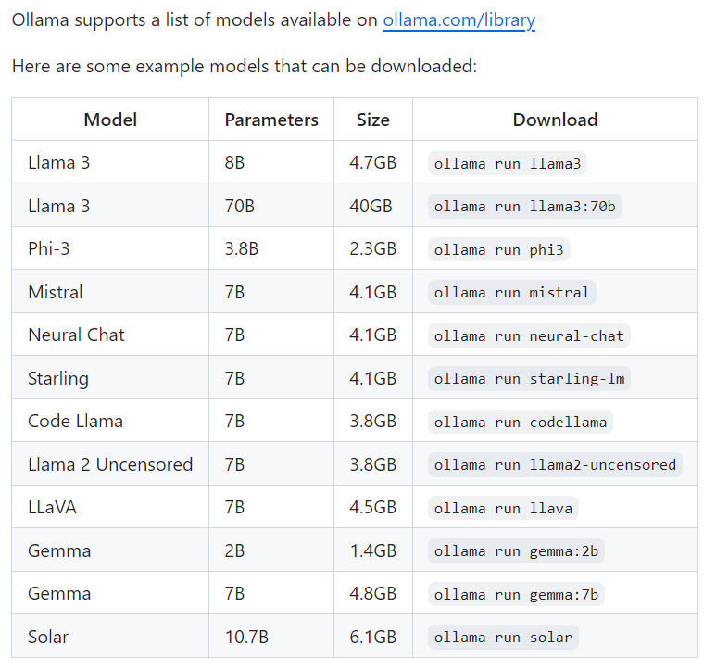

Ollama list of LLM models available
LLM on your own linux machine or linux server

Slide 16
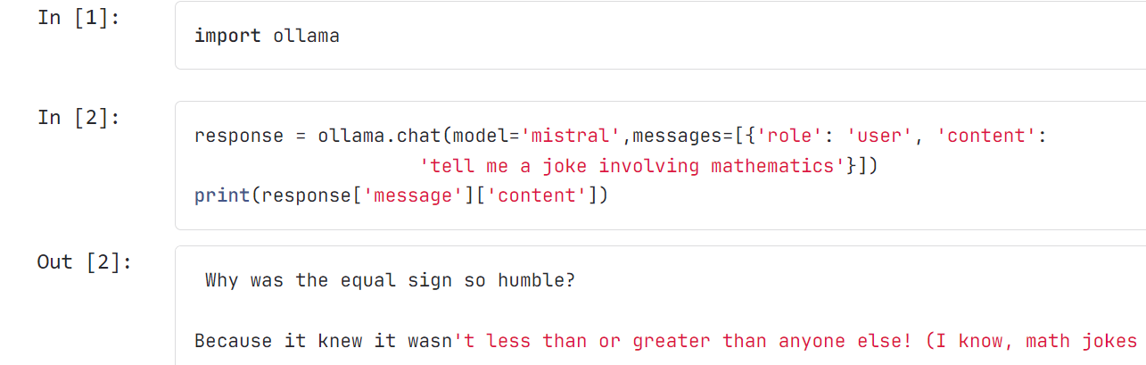
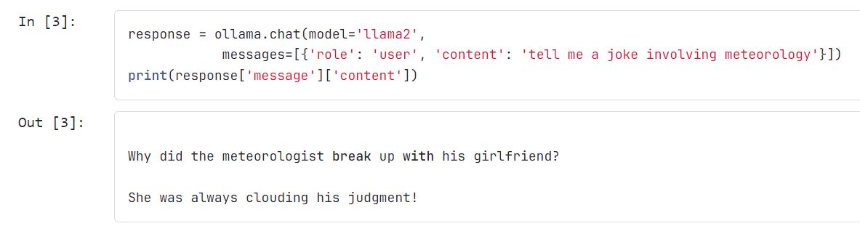
Now use Ollama in your python notebook by importing Ollama
Local access to your LLM

Slide 17
Arguments for Private and Open-Source LLM Solutions
Criteria |  | Commercial LLM API |  | Open Source Pre-Trained LLM
Expertise |  | Vendor provides expertise and support |  | Requires in-house expertise for deployment and tuning
R&D Budget |  | Initial costs (subscription fees); long-term may rise with usage |  | Low initial cost; long-term costs for infrastructure and maintenance
Time to Market |  | Faster implementation (ready-to-use solutions) |  | Slower setup; fine-tuning and deployment take time
Control over Model Quality |  | Limited control; dependent on vendor updates |  | Full control; can customize and optimize as needed
Data Privacy |  | Potential data sharing concerns with vendor |  | Full control; data remains in-house
Inference Speed |  | Generally optimized for speed by provider |  | Speed varies; may need optimization for production use
Cost Efficiency at Scale |  | Higher long-term costs with increased usage |  | More cost-effective at scale; mostly fixed costs

Slide 18
E-AI Basic Tutorials
Tutorial E-AI Basics 1: September 16, 2024, 11-12 CEST
Intro, Environment, First Example
1.1 Basic Ideas of AI Techniques (20') [SH]
1.2 Work Environment (20') [RP]
1.3 First Example for AI - hands-on (20') [JK]
Tutorial E-AI Basics 2: September 18, 2024, 13-14 CEST
Dynamics, Downscaling, Data Assimilation Examples
2.1 Dynamic Prediction by a Graph NN (20') [RP]
2.2 Data Recovery/Denoising via Encoder-Decoder (20') [SH]
2.3 AI for Data Assimilation (20') [JK]
Tutorial E-AI Basics 3: September 23, 2024, 11-12 CEST
LLM Use, Transformer Example, RAG
3.1 Intro to LLM Use and APIs (20') [RP]
3.2 Transformer for Language and Images (20') [JK]
3.3 LLM Retrieval Augmented Generation (RAG) (20') [SH]
3.2
AI generated Images, © Roland Potthast 2024

Slide 19
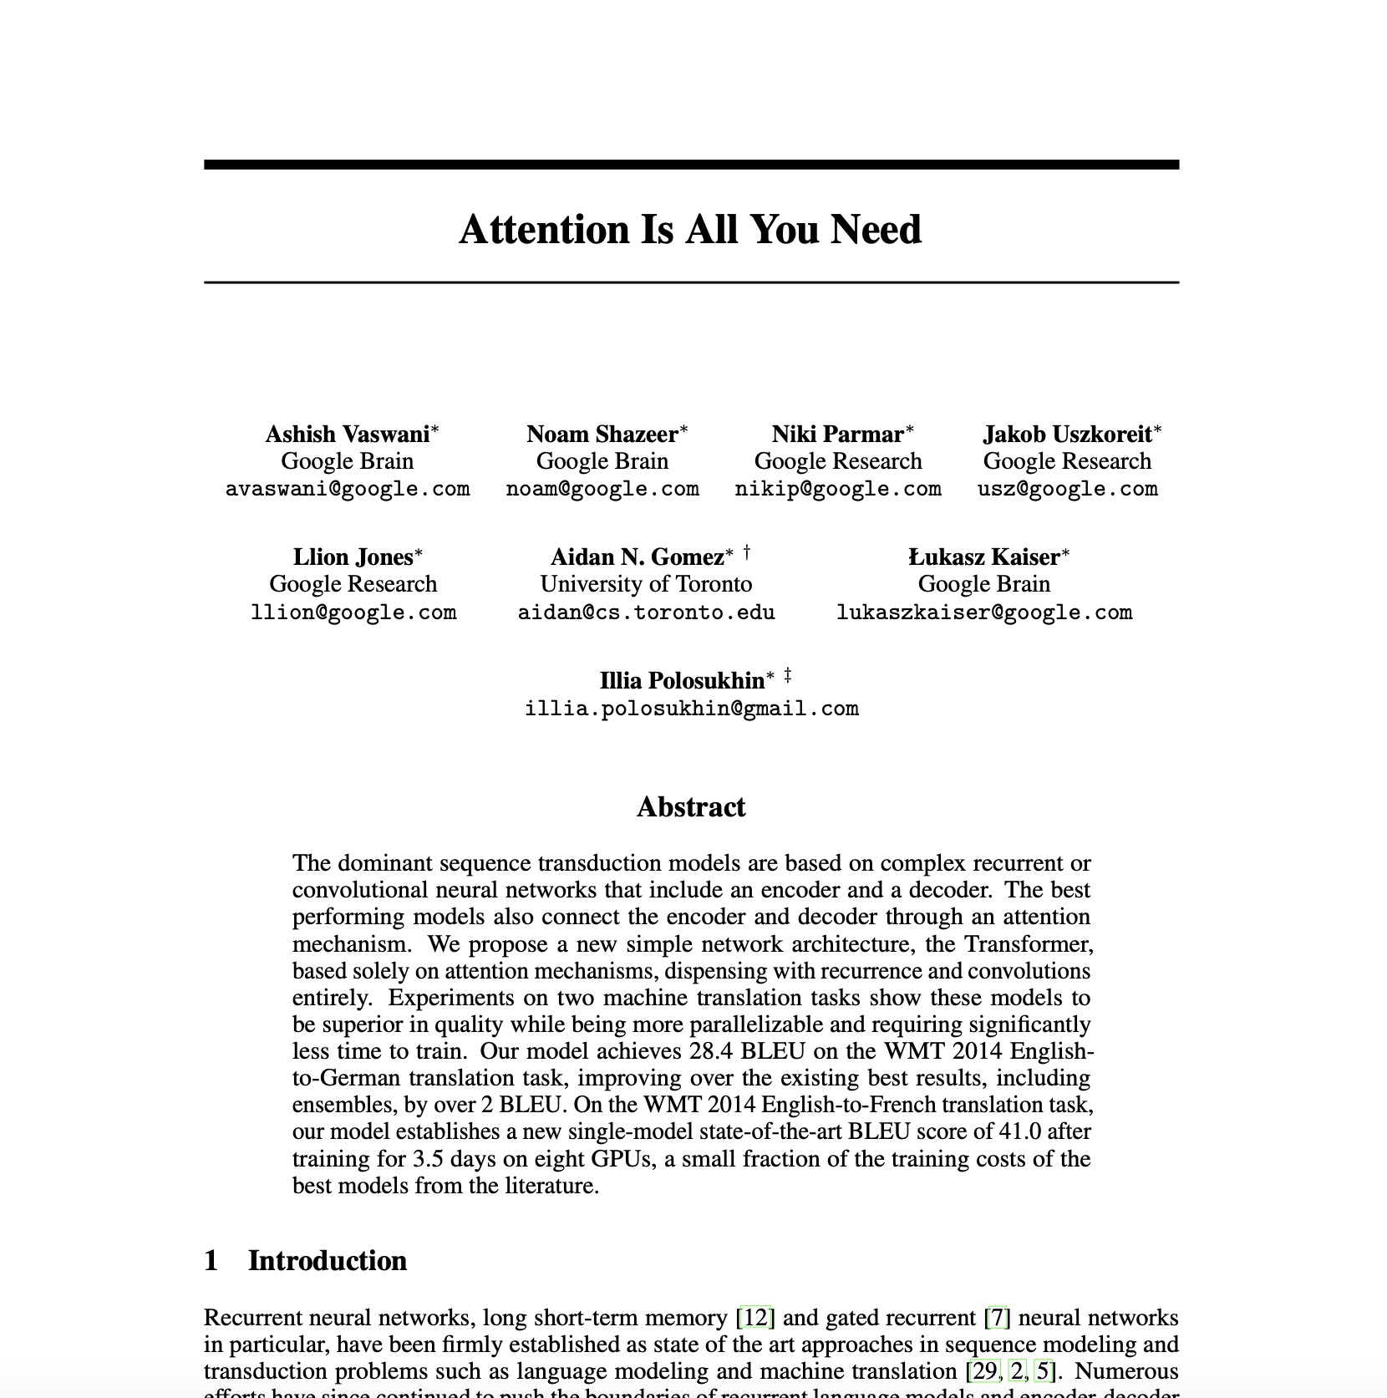
Transformer architectures
Transformers process all tokens in a sequence simultaneously, which significantly speeds up training and inference.
Transformers leverage the self-attention mechanism to capture relationships between (distant) tokens.
Transformers can be easily scaled by adjusting the number of layers and attention heads, allowing for models to grow in capacity as needed.
Vaswani et al., 2017

Slide 20
Attention Mechanism
The attention mechanism allows the model to focus on specific parts of the input sequence when producing each output. It dynamically weighs the importance of different tokens.
First, tokenize the input: “The weather is really warm.” and create embeddings
The
1
weather
2
is
3
really
4
warm.
5

Slide 21
Attention Mechanism
Query, Key, Value:
Queries Q Represent the current token needing information.
Keys K Represent all tokens in the sequence.
Values V The actual information associated with each token.
Vectors and Matrices (embeddings)

Slide 22
Attention Mechanism
Attention Scores are calculated using the dot product of Q and K. Higher scores indicate more relevant tokens.
The scores are then normalized using softmax to create a probability distribution, and the values are summed accordingly.
Multi-head attention

Slide 23
Self-Attention Mechanism
Specific type of attention to create contextual embeddings
Each token considers other tokens in the sequence, allowing to capture relationships regardless of their distance in the text.
Effective for long sequences, as each token can reference all others in a single computation step
Generate a new representation for each token based on its attention to all other tokens.

Slide 24
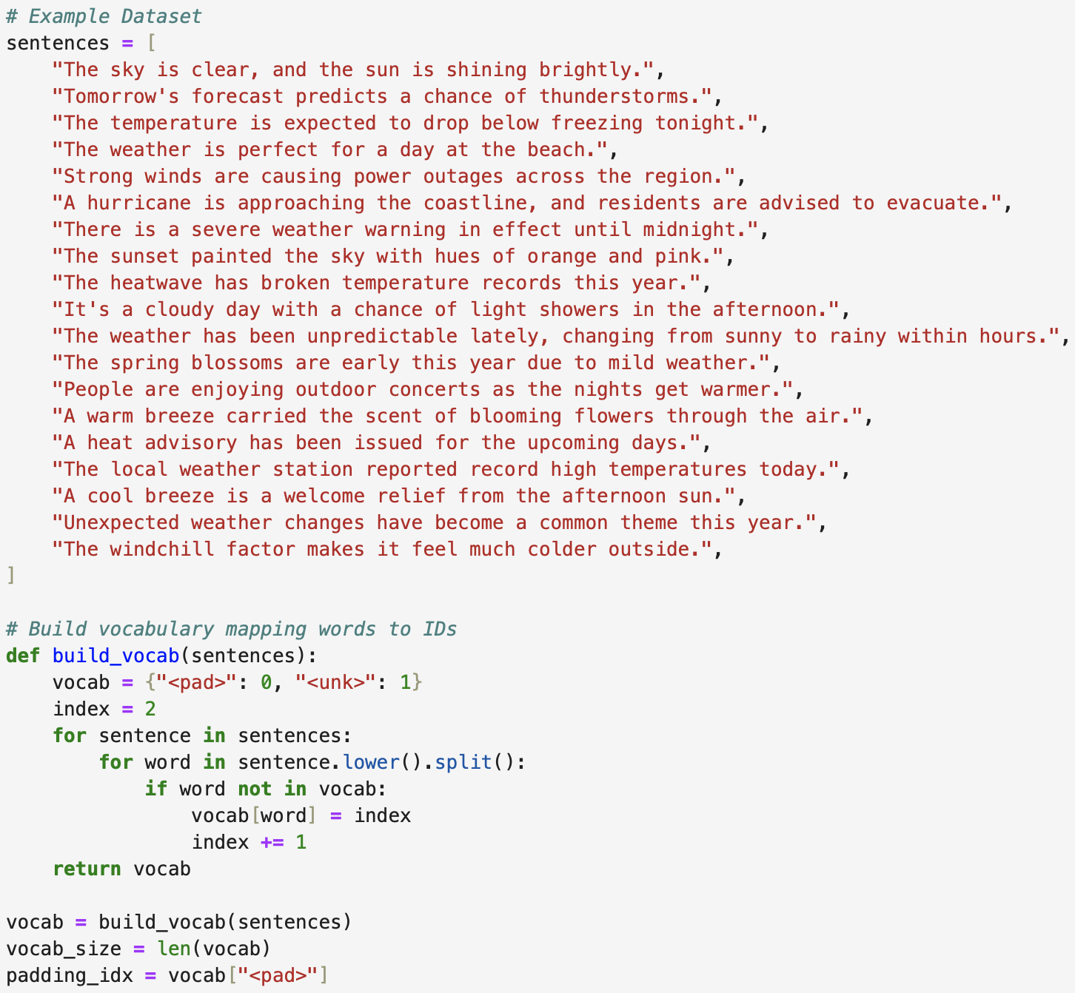
Text generation example
Generate the data to train the model on

Slide 25
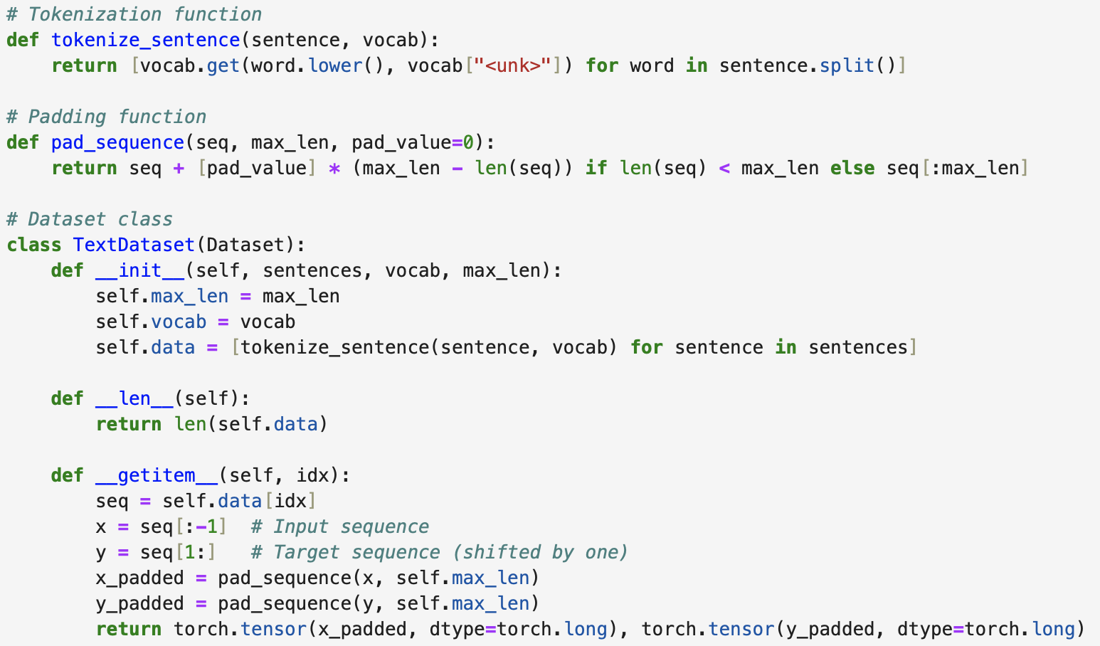
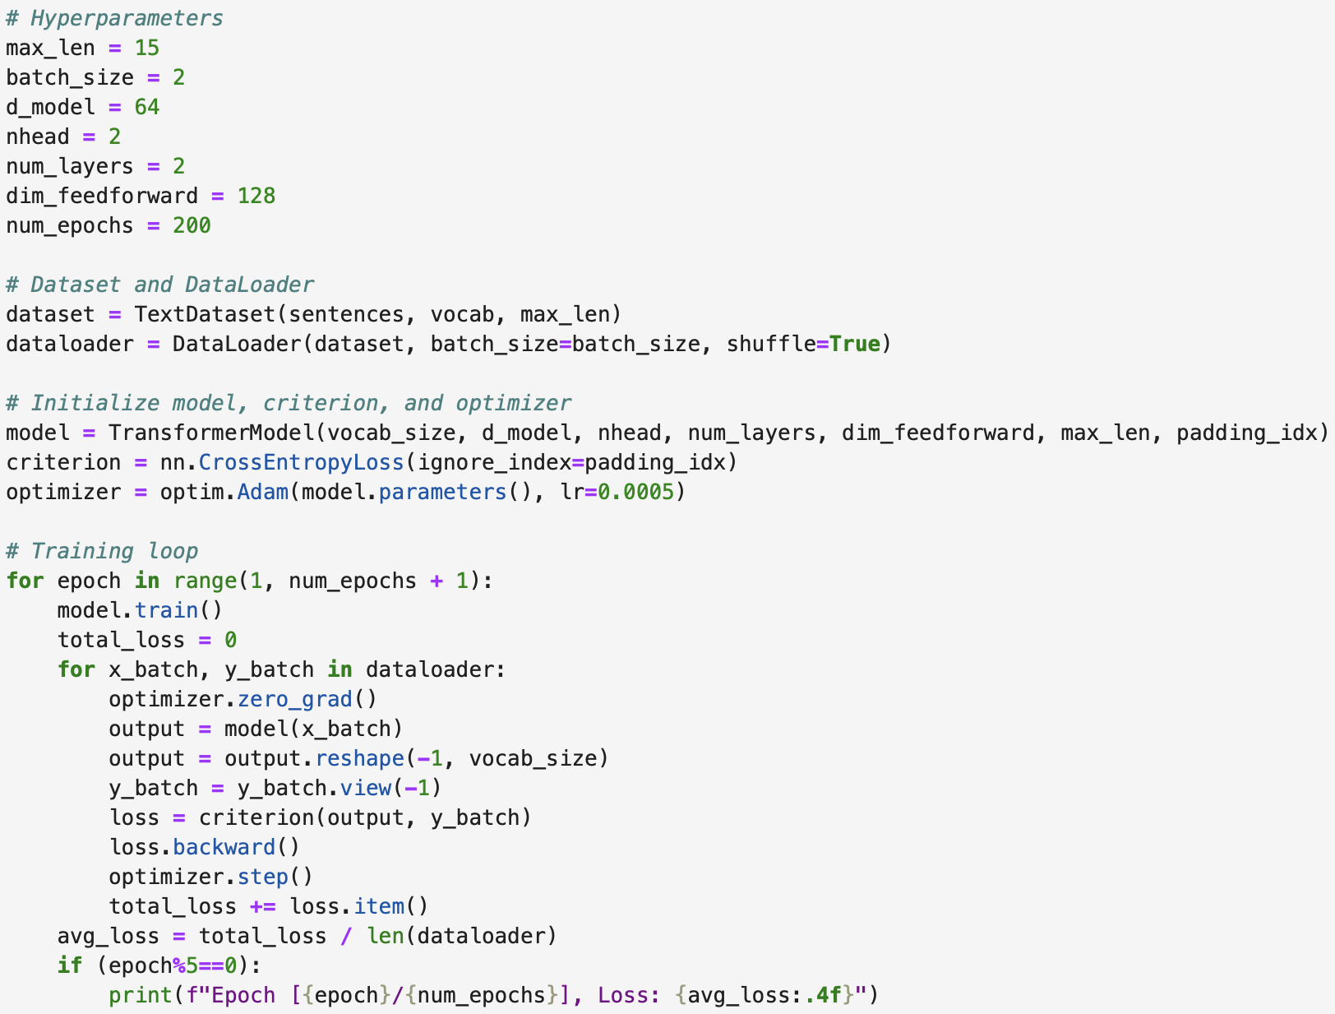
Text generation example
Tokenize the input and set up the data set

Slide 26
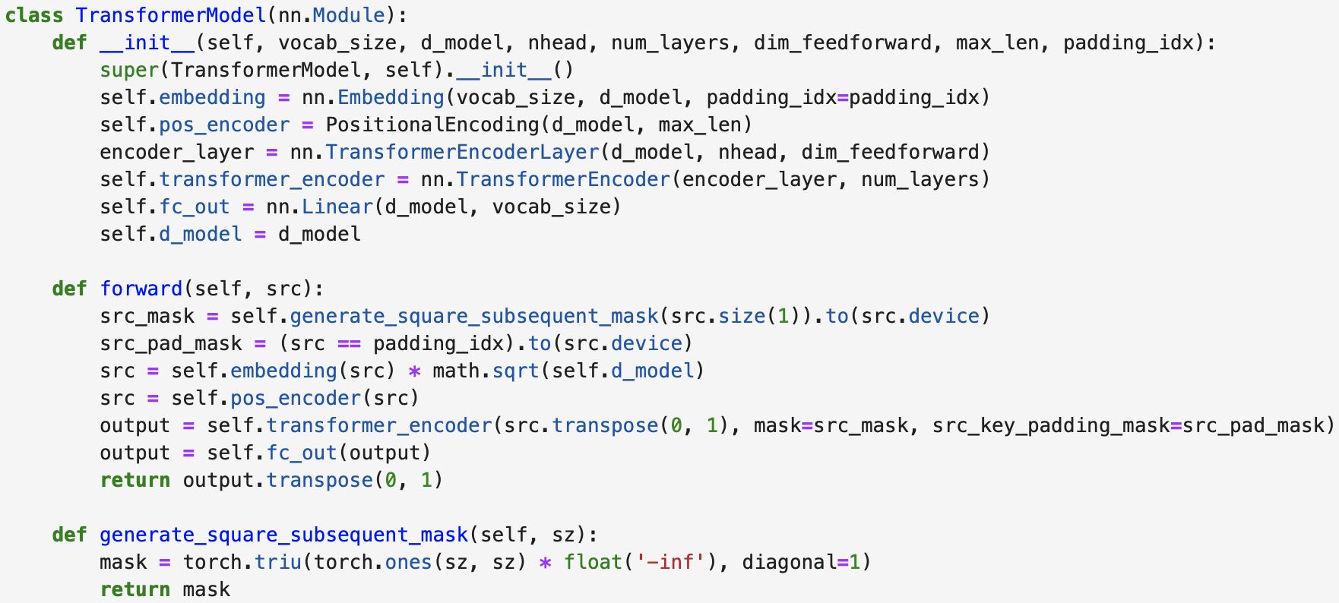
Text generation example
The transformer model
Attention!

Slide 27
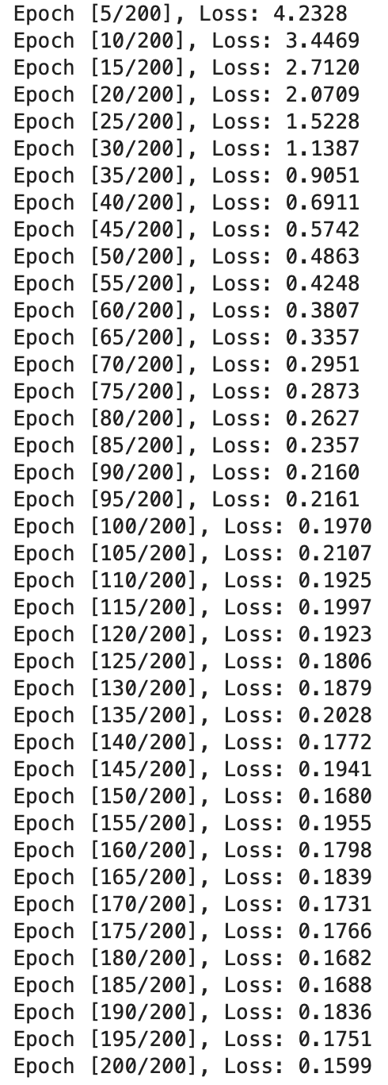
Text generation example
Training loop

Slide 28
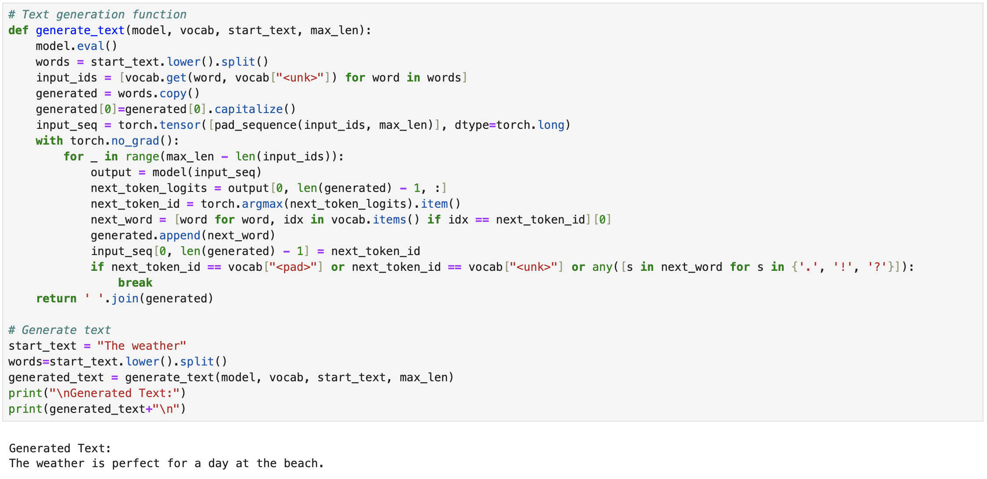
Text generation example
Inference

Slide 29
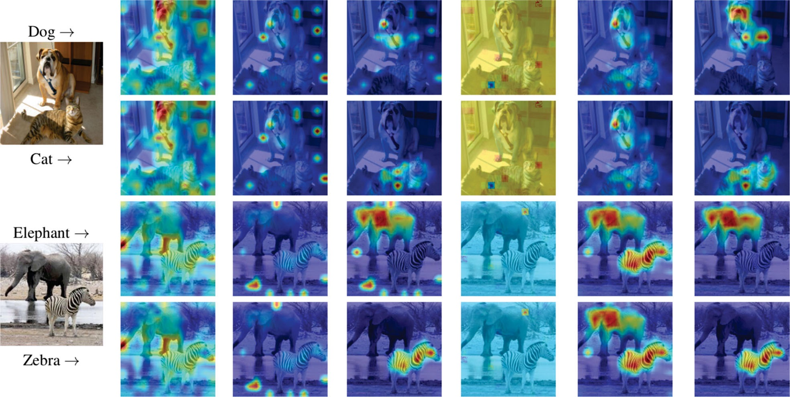
Transformers for images
Visualization of attention as a heatmap
Adaption von Xu et al. (2022)

Slide 30
E-AI Basic Tutorials
Tutorial E-AI Basics 1: September 16, 2024, 11-12 CEST
Intro, Environment, First Example
1.1 Basic Ideas of AI Techniques (20') [SH]
1.2 Work Environment (20') [RP]
1.3 First Example for AI - hands-on (20') [JK]
Tutorial E-AI Basics 2: September 18, 2024, 13-14 CEST
Dynamics, Downscaling, Data Assimilation Examples
2.1 Dynamic Prediction by a Graph NN (20') [RP]
2.2 Data Recovery/Denoising via Encoder-Decoder (20') [SH]
2.3 AI for Data Assimilation (20') [JK]
Tutorial E-AI Basics 3: September 23, 2024, 11-12 CEST
LLM Use, Transformer Example, RAG
3.1 Intro to LLM Use and APIs (20') [RP]
3.2 Transformer for Language and Images (20') [JK]
3.3 LLM Retrieval Augmented Generation (RAG) (20') [SH]
3.3
AI generated Images, © Roland Potthast 2024

Slide 31
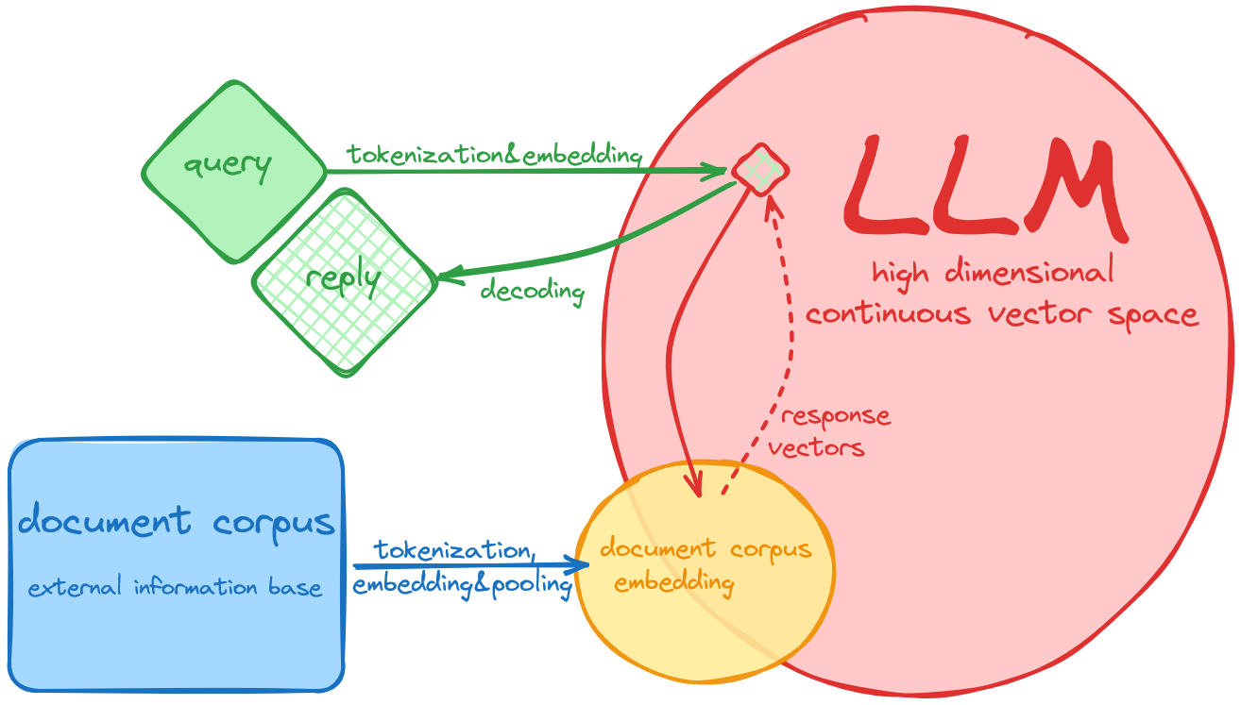
Retrieval-Augmented Generation
Retrieval-Augmented Generation (RAG) is an approach that combines information retrieval from external knowledge sources with a language model to generate more informed and accurate responses by retrieving relevant documents or data before generating an answer.
Core Components for RAG are
LLM: The pre-trained language model (e.g., BERT, GPT) that generates the responses. It has been trained on a broad, general corpus during training.
Corpus: The external, domain-specific information provided to the RAG system to improve retrieval and enhance the LLM's output. The LLM uses this corpus at inference time to "look up" relevant information rather than relying solely on its pre-trained knowledge.

Slide 32
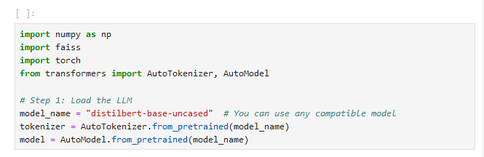
Load the Language Model and Tokenizer
You will need the following libraries installed in your environment:
transformers: For handling tokenization and model loading.
torch: For handling tensors and leveraging the pre-trained model.
faiss: For building a vector search engine.
Here, we use DistilBERT, a pre-trained language model with tokenizer from Hugging Face.
tokenizer: Tokenizes the input text into numerical format.
language model: Outputs embeddings for the tokenized input, representing the text in a high-dimensional space.
A tokenizer transforms raw input text (e.g., sentences or documents) into tokens (smaller units of text) that can be understood and processed by a language model. These tokens are usually numerical representations that the model can use as inputs.
Embedding refers to the process of converting tokens (usually token IDs) into dense, continuous vectors that represent the semantic meaning of the text. The embedding is a learned representation that captures the relationships between tokens in a high-dimensional space.

Slide 33
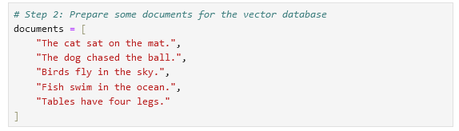
Prepare Documents for the Vector Database
Next, define some example documents that will be stored in the vector database. Each document will later be encoded into vectors for efficient similarity search. These documents represent a small collection, but in a real-world scenario, you'd use a much larger document set.
The vector base is a specialized database that stores document embeddings and enables efficient similarity search between query and document vectors. It uses distance metrics to retrieve the most relevant documents, which are then passed to the language model to generate a response. By using vector-based search, RAG systems can provide more accurate and contextually relevant answers.

Slide 34
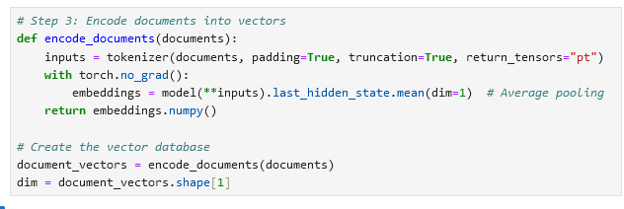
Encode Documents into Vectors
We create a function to encode the documents into vectors using the pre-trained language model. We use average pooling over the token embeddings to generate a single fixed-size vector for each document. This function takes in a list of documents, tokenizes them, and then passes them through the language model to get the embeddings (vector representations).
Pooling refers to the process of combining the individual token embeddings from a sequence (e.g., a sentence or document) into a single vector that represents the entire sequence.
Tokenization breaks text into tokens, and each token is mapped to an embedding.
Pooling reduces token-level embeddings into a single fixed-size vector to represent the entire document or query. Different types of pooling (mean, max, CLS) are used depending on the task and model.

Slide 35
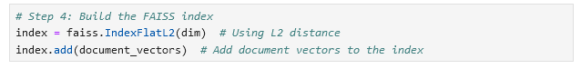
Build the FAISS Index
We use FAISS, a library for efficient similarity search, to build the vector search engine. The IndexFlatL2 method builds an index that uses L2 distance (Euclidean distance) for similarity search. This is the simplest type of FAISS index, where all vectors are stored and compared using brute-force search. This is effective only for small datasets but scales poorly with large datasets.
FAISS provides several types of indexes, each optimized for different use cases.
The FAISS index is a core component of the FAISS (Facebook AI Similarity Search) library, designed to enable fast and efficient similarity search and clustering of high-dimensional vectors. In the context RAG, FAISS is used to efficiently find the nearest neighbors (most similar vectors) in a large corpus of vector representations (document embeddings).

Slide 36
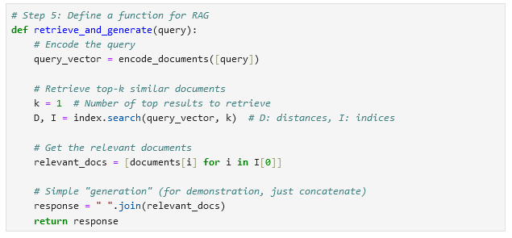
Define the RAG Function
In this step, we implement the core function of the RAG system, which involves:
Encoding the query into a vector.
Searching for the most similar document vectors using the FAISS index.
Returning the relevant document(s) as the "retrieved" portion of RAG.
Generating a response (here, we just return the retrieved documents).
In a more advanced setup, instead of just concatenating the documents, you could pass the relevant documents back into a model like GPT to generate a more complex answer. Here, for simplicity, we just concatenate the top retrieved document.

Slide 37
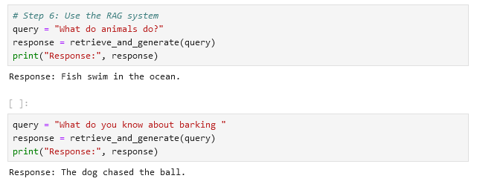
Use the RAG System
Finally, let's test the system with a sample query.

Slide 38
E-AI Basic Tutorials
Many Thanks
Tutorial E-AI Basics 1: September 16, 2024, 11-12 CEST
Intro, Environment, First Example
1.1 Basic Ideas of AI Techniques (20') [SH]
1.2 Work Environment (20') [RP]
1.3 First Example for AI - hands-on (20') [JK]
Tutorial E-AI Basics 2: September 18, 2024, 13-14 CEST
Dynamics, Downscaling, Data Assimilation Examples
2.1 Dynamic Prediction by a Graph NN (20') [RP]
2.2 Data Recovery/Denoising via Encoder-Decoder (20') [SH]
2.3 AI for Data Assimilation (20') [JK]
Tutorial E-AI Basics 3: September 23, 2024, 11-12 CEST
LLM Use, Transformer Example, RAG
3.1 Intro to LLM Use and APIs (20') [RP]
3.2 Transformer for Language and Images (20') [JK]
3.3 LLM Retrieval Augmented Generation (RAG) (20') [SH]
Enjoy AI Development
AI generated Images, © Roland Potthast 2024

